Slide 1
EP SDK入门

Slide 2
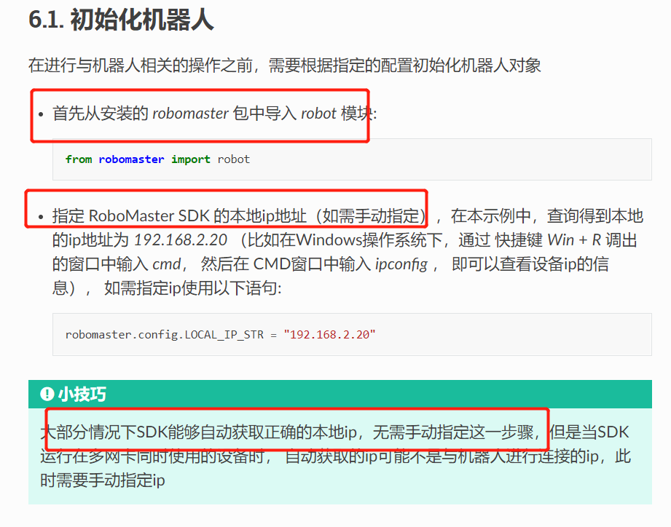
案例：Set_drone_mled
C:\Users\htl\AppData\Local\Programs\Python\Python37\Lib\site-packages\robomaster

Slide 3
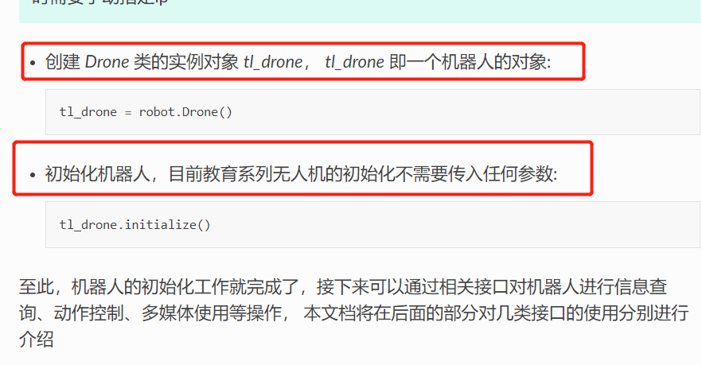

Slide 4
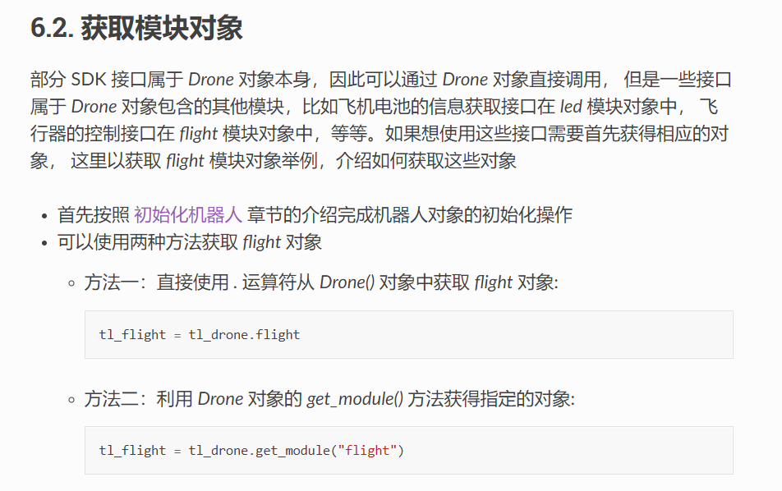

Slide 5
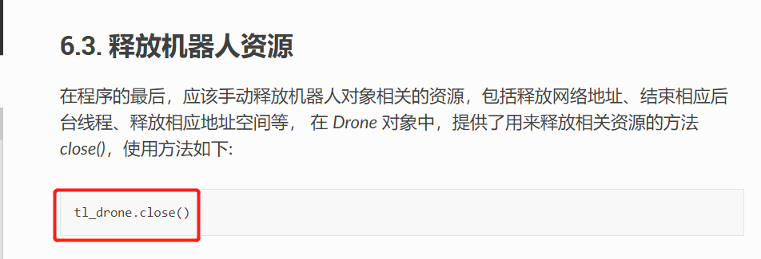

Slide 6
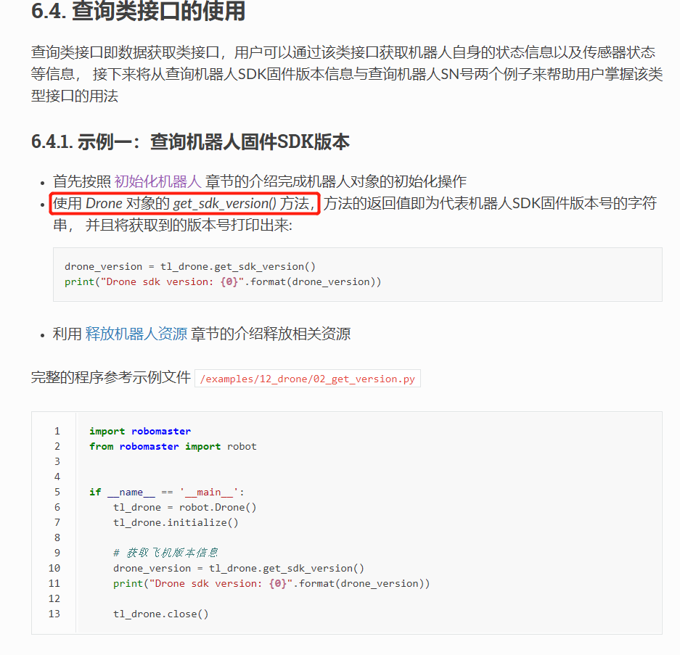

Slide 7
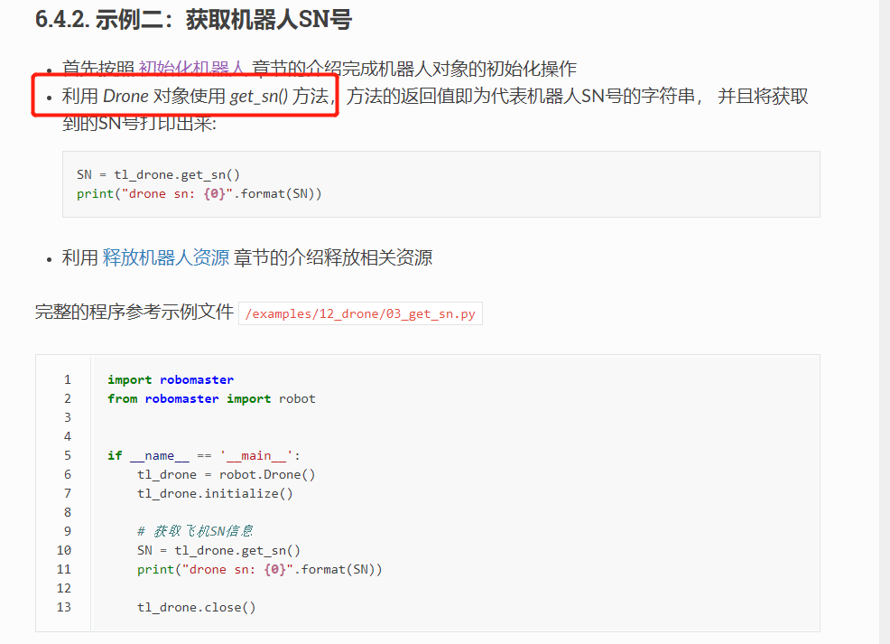

Slide 8
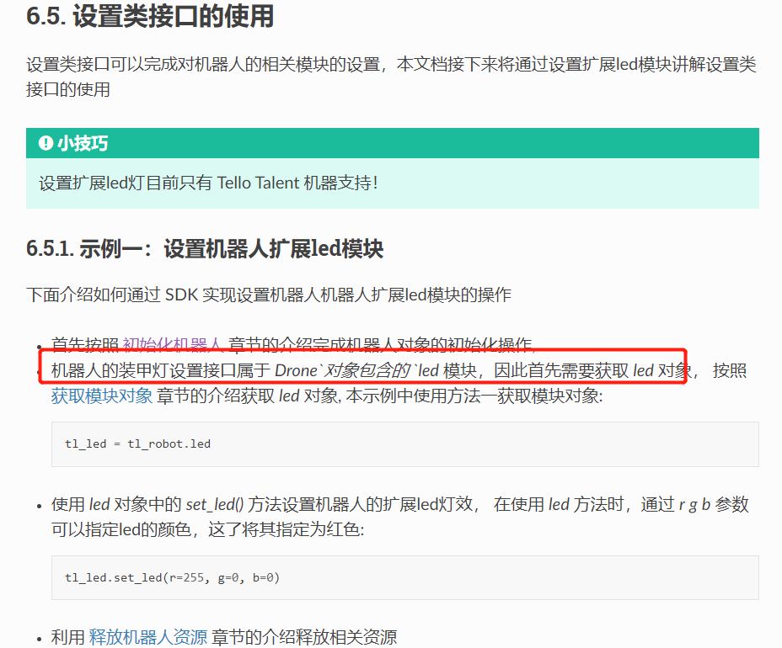

Slide 9
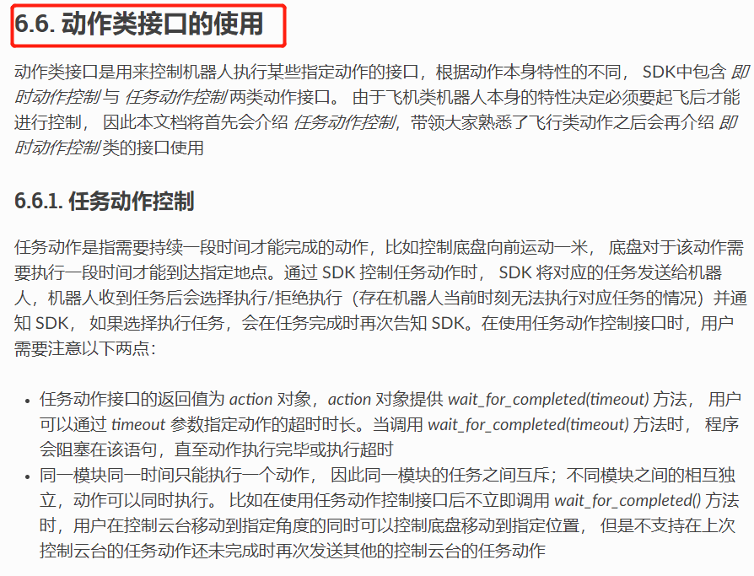

Slide 10
tt_drone.led.set_mled_char(color='b',display_char='C')

